Slide 1

IE 212: Computational Methods for Industrial Engineering
Lecture Notes #2:
The Visual Basic Editor
The Visual Basic for Applications Programming Language
Dr. J. David Porter
Winter 2013

Slide 2
Outline
In this module, the following topics will be covered:
  The basics of the Visual Basic Editor (VBE) environment
    Project Explorer Window
    Properties Window
    Code Window
  Introduction to the Excel Visual Basic for Applications (VBA) programming language
    The Excel object model
    The difference between a property, a method, and an event
    Fundamental skills for reading, understanding, and writing basic Excel VBA code
  Basic user interface development
    Assigning macros to shapes (i.e., buttons)

Slide 3
The Visual Basic Editor (VBE)

Slide 4
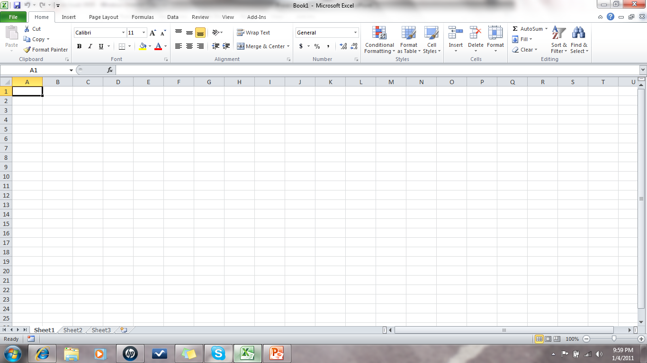
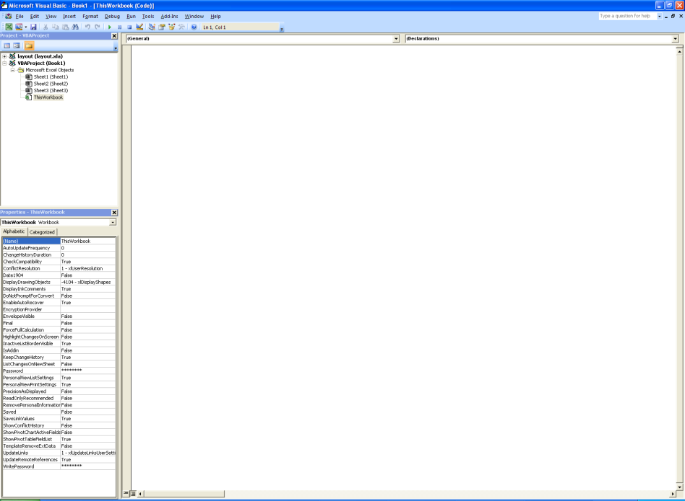
The Visual Basic Editor
The Visual Basic Editor (VBE) is the environment in which you work with Excel VBA code
Excel and the VBE have separate windows
  You can toggle between as needed by pressing Alt+F11
Excel
VBE

Slide 5
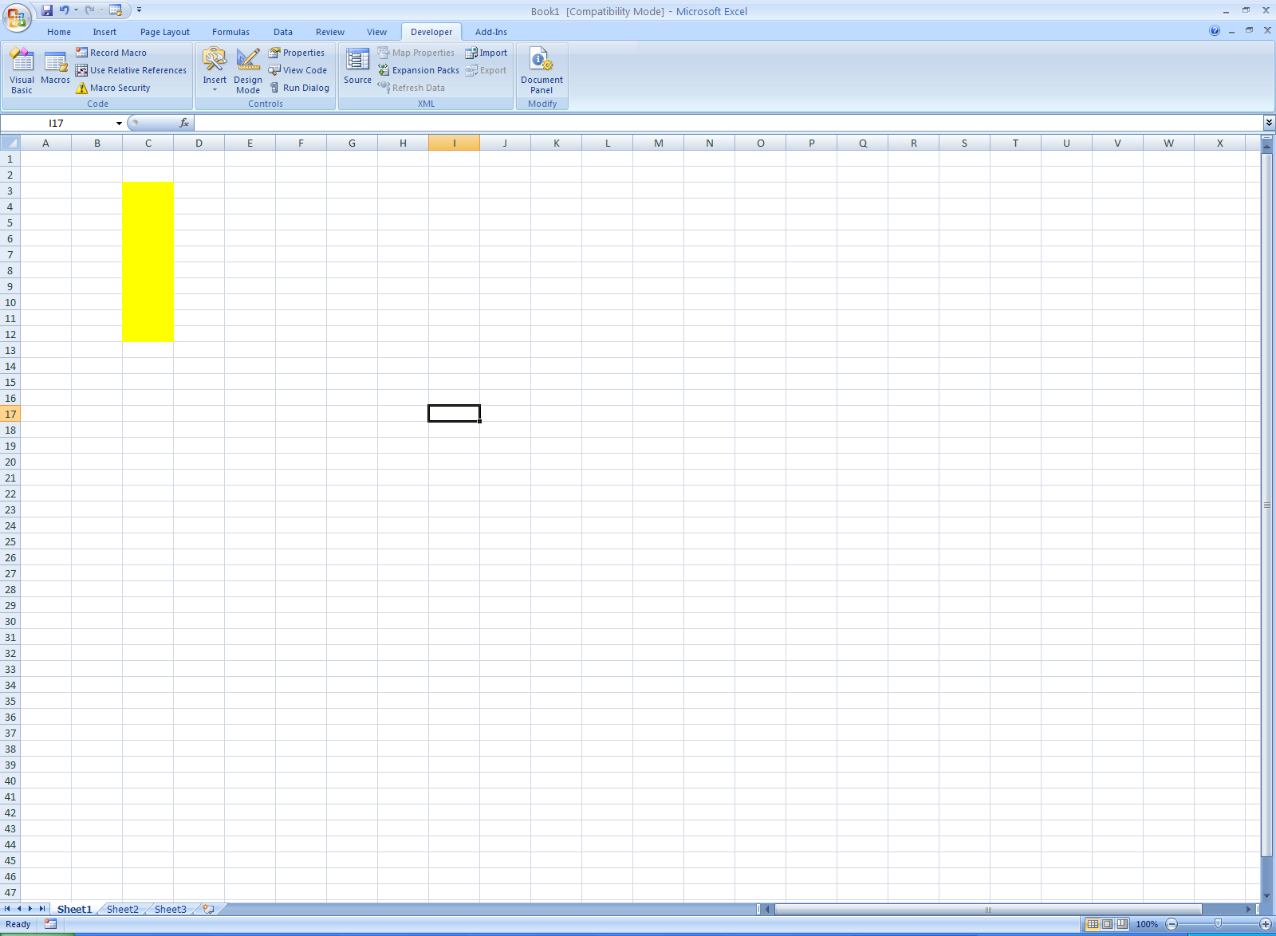
The Visual Basic Editor (cont.)
Access the VBE through the Developer Ribbon (Excel 2007)
    Open the MS Office menu by clicking the Office button
    Open the Excel Options menu (button on the left in the lower right corner of the menu window)
    Make sure the option Popular is selected from the menu on the left
    Check the box Show Developer Tab in Ribbon
    Click OK

Slide 6
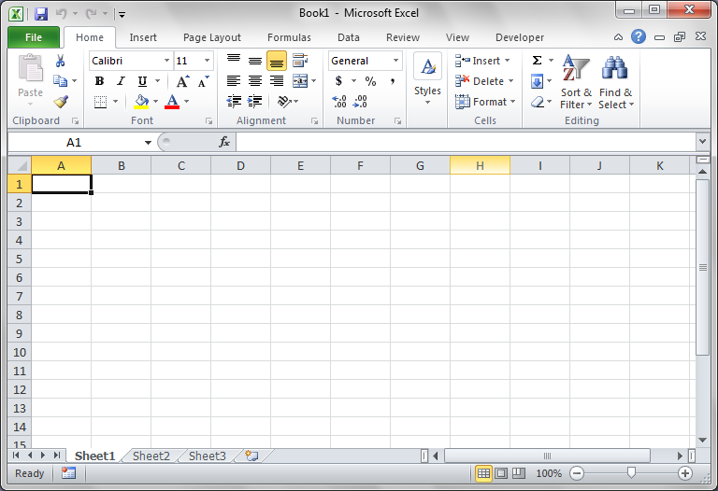
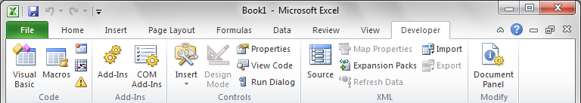
The Visual Basic Editor (cont.)
Access the VBE through the Developer Ribbon (Excel 2010)
    Open Excel 2010 and click on the green tab labeled “File”
    Click on “Options” (the window “Excel Options” will appear)
    Click on “Customize Ribbon”
    Make sure the entry in the combo box labeled “Customize the Ribbon” reads “Main Tabs”
    Select the option “Developer”
    Click OK

Slide 7
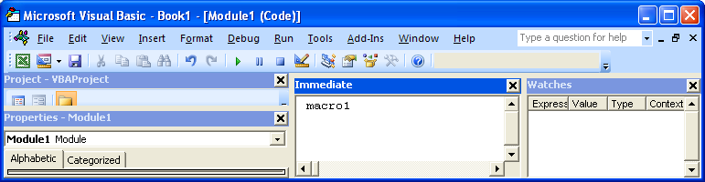
The Visual Basic Editor (cont.)
There are three main windows in the VBE
  Project Explorer Window
  Properties Window
  Code Window
There are two other windows in the VBE, mainly used for debugging
  Immediate Window
  Watch Window
VBE Toolbars
  Standard toolbar

Slide 8
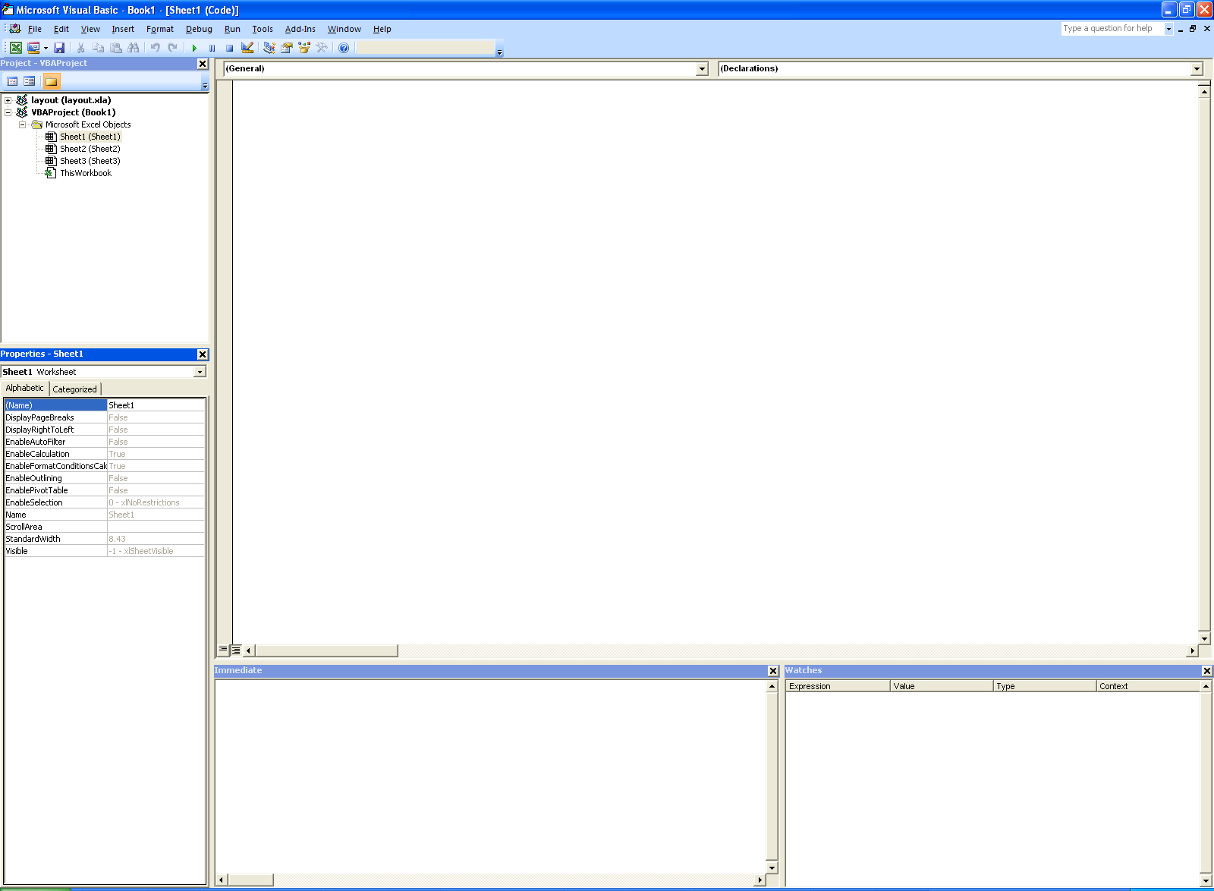
The Visual Basic Editor (cont.)
The VBE’s windows
Project
Explorer
Code
Window
Properties
Window
Watch
Window
Immediate
Window

Slide 9
Project Explorer
Lists all projects in any open workbook
Each workbook has a project, and each project can have several parts
  Objects (e.g., workbook and worksheets)
  Modules
  Forms
In the VBE, you can use Insert > Module to add a new module to the current project
  Can also use icon from standard toolbar

Slide 10
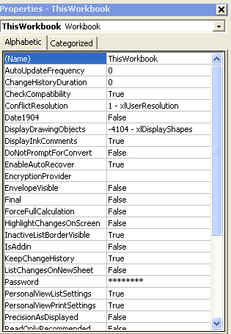
Properties Window
Contains detailed information about any selected part of a project in the Project Explorer
Some basic naming and formatting properties can be modified for worksheets and workbooks
Properties are very important for user forms
  Formatting
  Position
  Picture
  Scrolling
  Behavior
Notes:
User forms will be discussed in detail in Ch 18
Properties can be viewed by two options
Alphabetic
Categorized

Slide 11
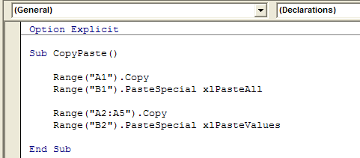
Code Window
Displays the VBA code for the highlighted part of a project in the Project Explorer
When macros are recorded, VBA code is simultaneously created and can be edited in the VBE
You will write your own code in this window, once you are more familiar with Excel VBA

Slide 12
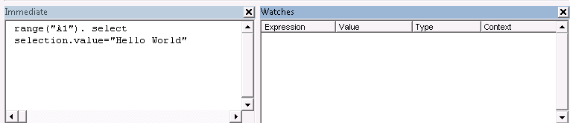
Immediate and Watch Windows
Both of these windows are used for debugging
  The Immediate Window executes whatever is entered immediately
  The Watch Window displays values of inserted variables
Use the View menu option to view or hide any window

Slide 13
The Excel VBA Programming Language

Slide 14
Visual Basic for Applications
Visual Basic for Applications (VBA) brings a dynamic element to spreadsheet DSS applications
VBA can be used to perform the same spreadsheet functions that are done in Excel along with some other advanced Excel object manipulation
For example, VBA can be used to:
  Modify a spreadsheet
  Create a user interface
  Perform simulation models, and
  Solve optimization problems

Slide 15
Visual Basic for Applications (cont.)
The VBA programming language is common across all Microsoft (MS) Office applications
  In addition to Excel, you can use VBA in Word, PowerPoint, Access and Outlook
When you work with a particular application, you need to learn about the objects it contains
  E.g., Word → Documents, paragraphs, words, etc.
Each MS Office application has a clearly defined set of objects according to the relationships among them
  This structure is referred to as the application’s object model

Slide 16
The Excel Object Model
Objects in Excel include (but are not limited to)
  Workbooks and worksheets
  Cells and ranges of cells
  Charts and shapes
There is an object hierarchy which orders these objects
  Workbooks contain worksheets
  Worksheets contain ranges
  Ranges contain cells
Objects in Excel are manipulated in VBA via
  Properties
    Physical characteristics of objects and can be measured or quantified
  Methods
    Actions that can be performed by objects or on objects

Slide 17
The Excel Object Model (cont.)
Objects in Excel also respond to events
  Double-click on a cell
  Opening or closing a workbook
  A recalculation of a worksheet

Slide 18
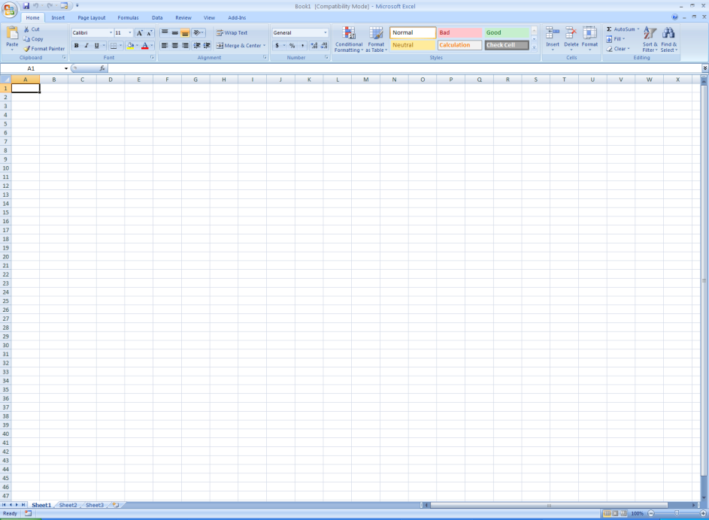
The Excel Object Model (cont.)
Workbook
Cell Range
Cell
Worksheets

Slide 19
Macros
Macros will be used to illustrate basic Excel VBA coding
  Recording macros creates VBA code automatically
    This code can be studied
  Macros are useful in developing the fundamental skills for reading, understanding, and writing VBA code
Main topics will include
  Recording a macro
  Writing simple VBA procedures
  Creating event procedures
  Assigning macros to drawing objects in Excel

Slide 20
Macros (cont.)
Macros are technically defined as units of VBA code
  A macro automates a repetitive series of actions in an Excel spreadsheet application
  Macros can be recorded in Excel or created directly by writing VBA code in the Visual Basic Editor (VBE)
In VBA, macros are referred to as procedures
  There are two types of procedures
    Sub procedures
    Function procedures
  The macro recorder can only produce sub procedures
To record a macro, we must know exactly the actions we wish to perform and then use the Macro Recorder

Slide 21
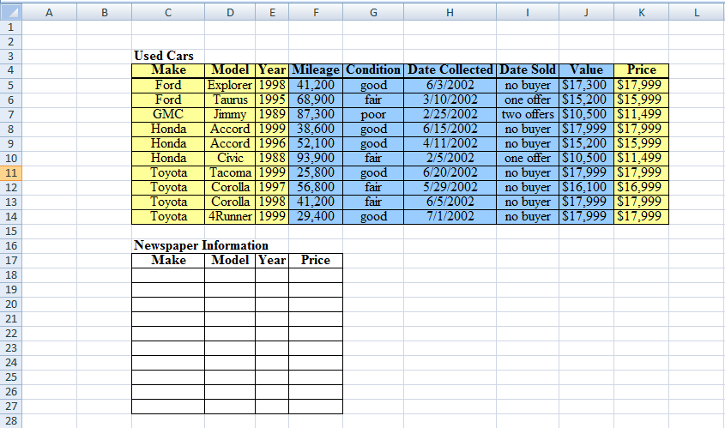
Macro Example
Let us record a macro to copy and then paste data
  Open Excel file CarDealer_Example.xls
A dealer wants to send the information from the first three columns and last column of the data table (highlighted in yellow) to a newspaper

Slide 22
Macro Example (cont.)
We should first review/practice the steps we will take when recording the macro
  Highlight (i.e., select) the first three columns of data with the cursor (C5:E14)
  Copy the selection using CTL+C
    You can also right-click the selection and click on Copy
  Highlight (i.e., select) cell C18
  Paste the data using CTL+P
    You can also right-click the selection and click on Paste
  Highlight (i.e., select) the last column (K5:K14)
  Copy the selection using CTL+C
  Highlight (i.e., select) cell F18
  Paste using CTL+P
  Select cell A1 and then press Esc
Notes:
Another way to do this is by holding down CTL to select the non-adjacent ranges

Slide 23
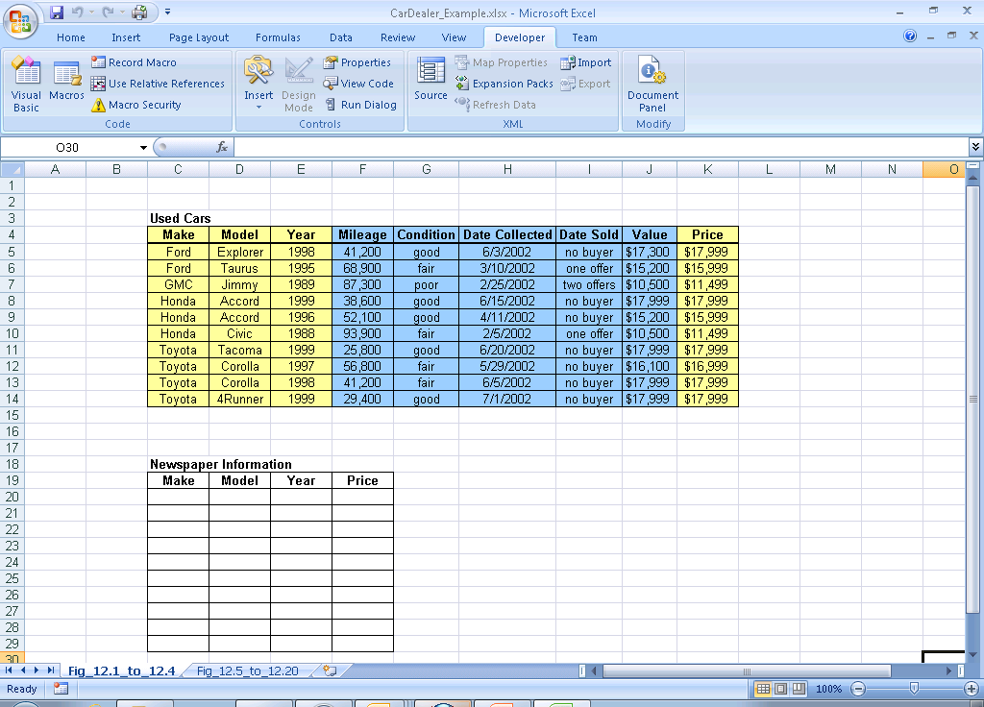
Macro Example (cont.)
Now we are ready to record the macro
You can do this in several different ways
  Select View > Macros > Record Macro…
  Record Macro button from the Developer Toolbar
  Click on the Record Macro icon located next to the legend “Ready” on the lower left corner of the workbook

Slide 24
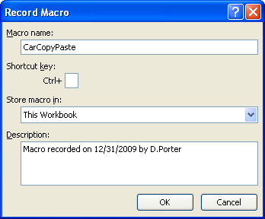
Macro Example (cont.)
When the Record Macro dialog box appears, we enter a name for the macro
  The macro name should begin with a letter and may contain only letters, numbers and the underscore (i.e., _) character
  Maximum length is 255 characters
  Do not use special characters (e.g., !, ?, &) or blank spaces
Use a short and descriptive name
  Use _ to separate words
    First_Macro
  Capitalization works well too
    FirstMacro
Enter CarCopyPaste as the macro name for this example

Slide 25
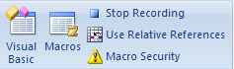

Macro Example (cont.)
Once you begin recording, notice that the Record Macro button is now the Stop Recording button
After finishing the steps needed to copy and paste the information, you can stop recording
  Select View > Macros > Stop Recording
  Click on the Stop Recording button from the Developer Toolbar
    There is also a Stop button on the lower left corner of the workbook
  Click on the square button next to the legend “Ready”

Slide 26
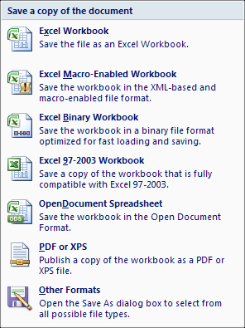
Saving Excel Files Containing Macros
When a normal workbook (i.e., one without macros) is saved, MS Excel 2007/2010 appends the standard .xlsx extension
For workbooks containing macros, the file must be saved as a Macro-Enabled file
  In this case, Excel appends the special extension .xlsm to these files
If you fail to save a file containing macros with the .xlsm extension, ALL YOUR WORK WILL BE LOST!

Slide 27
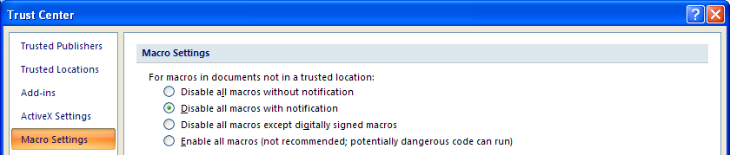
Macro Security
Macro security is an important feature since MS Excel 2007
  Because macros may be used to harm your computer
The level of protection can be set directly from the Developer ribbon by selecting Macro Security

Slide 28
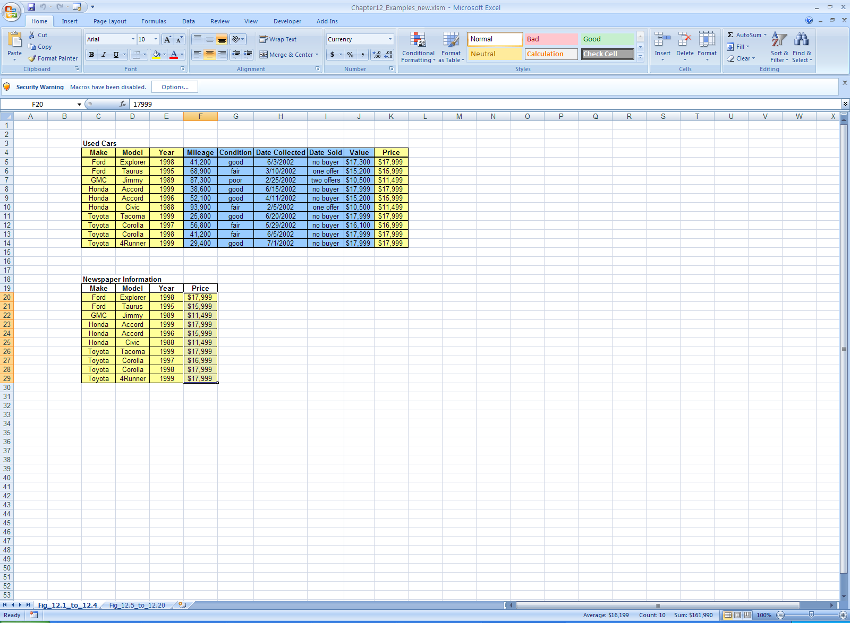
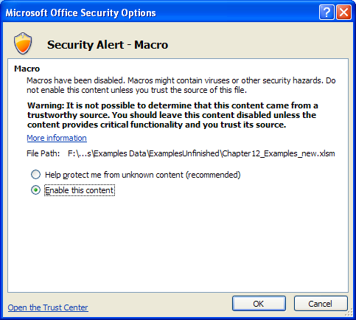
Macro Security (cont.)
When you open a spreadsheet that contains macros, Excel displays a warning on the ribbon alerting you that macros have been disabled
Click on the Options… button
Select Enable this content
Press OK

Slide 29
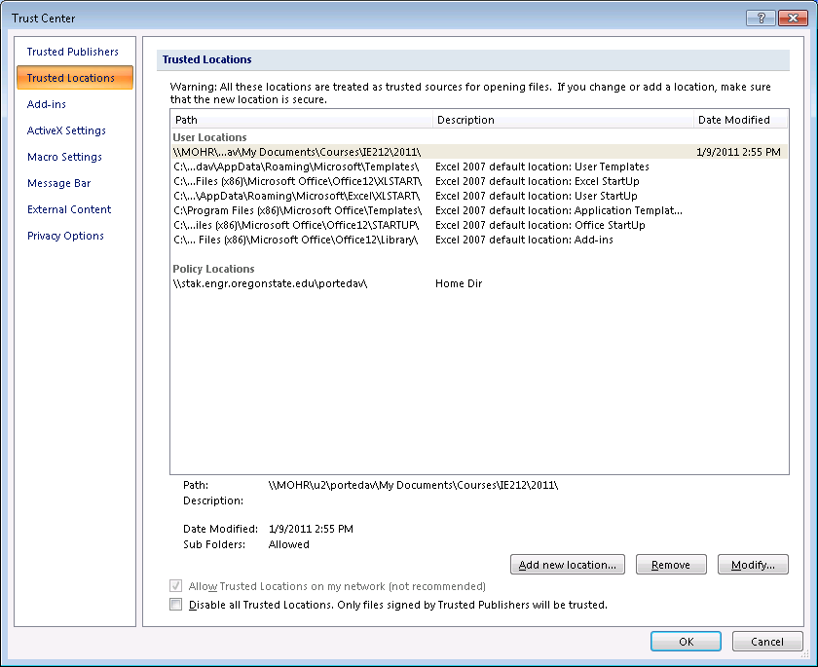
Macro Security (cont.)
To avoid having to authorize every spreadsheet with macros that is opened, define your working directory as a trusted location

Slide 30
Macro Security (cont.)
Save your file in the trusted locations that you just defined
  Make sure to save it as fileName.xlsm
Remember
  If you save your file with the extension .xlsx, all you macros will be lost!

Slide 31
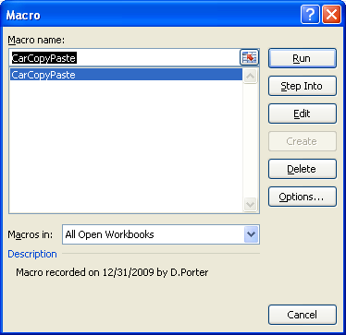
Running the Macro
Once you have recorded a macro, you can run it to ensure it works correctly
  Select View > Macros > View Macros
    Select macro “CarCopyPaste” from list and press Run
  Press button Macros on the Developer Toolbar
    Select macro “CarCopyPaste” from list and press Run
Notes:
We will check our VBA procedures the same way (after creating them in VBE, not recording them in Excel)

Slide 32
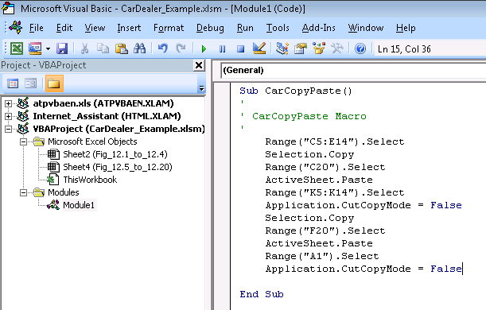
VBA Code
As we learned earlier, each time a macro is recorded in Excel, VBA code is generated automatically
Let us review what code was generated for this macro
  Go the VBE window (Alt-F11)
  A Modules folder has been added to the Project Explorer
  Expand the folder and select “Module1” to see the code in the Code Window

Slide 33
VBA Code (cont.)
Sub CarCopyPaste()
Range("C5:E14").Select
Selection.Copy
Range("C18").Select
ActiveSheet.Paste
Range("K5:K14").Select
Application.CutCopyMode = False
Selection.Copy
Range("F18").Select
ActiveSheet.Paste
Range("A1").Select
Application.CutCopyMode = False
End Sub
This is the initial statement of every sub procedure
  The Select method of the Range object selects the specified range of cells
  The Copy method is used on the Selection object
  The Paste method is used on the ActiveSheet object
  The CutCopyMode method removes the moving border
  These steps are repeated to copy and paste the last column
  This last cell selection can be added to avoid leaving the cells highlighted
This is the last statement of every sub procedure
Notes:
Note that this code could have just used the Copy method directly on the Range object
Paste method is used on ActiveSheet object, but PasteSpecial method can be used on Range object
Note that a comment can be added to the code by using the ‘ mark

Slide 34
Learning to Code in Excel VBA
VBA code generated when we record a macro can be studied
  This way, we can easily learn how to create a similar macro directly from VBA by copying the code generated

Slide 35
Creating New VBA Code (cont.)
Assume the dealer now wants to add vehicle mileage information to the previously recorded macro
  Mileage information is contained in range F4:F14
Write (do not record) code that accomplishes this
  Name your macro AddMileage()
Notes:
1. Notice that if the Criteria value is left blank, All is selected.

Slide 36
Event Procedures
Event Procedures connect events or actions of an Excel object to a specific macro of VBA code
  Click
  Change
  Activate
To find a list of available/applicable event procedures in VBE, look at the top of the Code Window
  Double click on the Sheet1 member of the Microsoft Excel Object tree
  Choose Worksheet from the object list combo box
    The label(General) is displayed in the combo box
  Choose the Change event from the event list combo box
    The label (Declarations) is displayed in the combo box
Notes:
There are many events for user forms as there are several possible objects on a user form as well

Slide 37
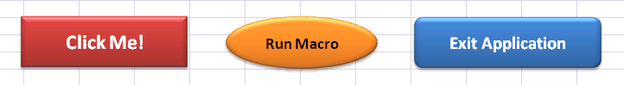
Assigning Macros to Shapes
MS Excel shapes (e.g., a rectangle) can be employed to simulate buttons
  Recall that shapes are also objects in Excel
Macros can then be assigned to these buttons
  Simplifies the process of running macros
  This is part of creating graphical user interfaces for DSS
Notes:
Note macros can be assigned from other workbooks, but those workbooks will be opened when the macro is run

Slide 38
Assigning Macros to Shapes (cont.)
To create a simple button do the following
  Select Insert > Shapes > (Select a Rectangular shape)
  Then add text to it by right-clicking it and choosing Edit Text
  Format the rectangle as desired
Notes:
Note macros can be assigned from other workbooks, but those workbooks will be opened when the macro is run

Slide 39
Assigning Macros to Shapes (cont.)
Once your button shape is ready, right-click on it and select Assign Macro from the drop-down list
  A list of all macros in the open workbooks will appear
Select a macro for your button to run
  Your button has become activated
We can now create buttons for each of the macros we previously wrote
  Create as many buttons as needed for your macros
  Assign a macro to each new button

Slide 40
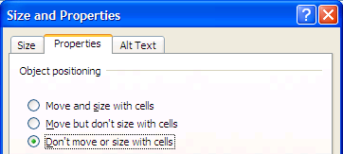
Buttons Shifting on Worksheet
You may notice that buttons sometimes shift inside the worksheet as macros are executed
Fix for drawn controls
  First, select a cell just outside the control and click it
  Right mouse-click on the button and select Size and Properties…
  Select the Properties tab and select the option “Don’t move or size with cells”
  Click Close
Notes:
Check to ensure they work properly
In complete example file, there are two more macros: View Economy Flights and View Business Flights
What needs to be modified to the View All code after this is done?

Slide 41
Limitations with Macros
Although keyboard macros are well worth learning, they are limited
In particular, they cannot do the following:
  Perform repetitive looping
  Perform conditional actions
    Take different actions depending on whether something is true or false
  Assign values to variables
  Specify data types
    Variables can store integers, decimal numbers, strings, etc.
  Display pop-up messages
  Display custom dialog boxes
These limitations are overcome by writing your own macros in VBA
Notes:
Check to ensure they work properly
In complete example file, there are two more macros: View Economy Flights and View Business Flights
What needs to be modified to the View All code after this is done?

Slide 42
Summary
The Visual Basic Editor (VBE) is the environment in which you work with VBA programming code
There are three main windows in VBE
  The Project Explorer Window
  The Code Window
  The Properties Window
The VBA programming language is common across all Microsoft (MS) Office applications
  Excel has a particular object model
  Objects in Excel can be manipulated by changing their properties or calling their methods

Slide 43
Summary (cont.)
Properties are the physical descriptions of all Excel objects
  The description of the particular property is called the value of the property
Methods are the actions that can be performed on the object
  The elements of a method statement are called the arguments of the method
Macros are technically defined as units of VBA code
Macros can be created directly with VBA code in the Visual Basic Editor or recorded in Excel

Slide 44
Summary (cont.)
Events are actions that can take place in the Excel window that cause an action to occur in the VBA code
An event procedure is just like a sub procedure, except that it is associated with a particular action of an Excel object

